Slide 1


Electric Circuits
Twelfth Edition, Global Edition
Chapter 4 – Part 1
Techniques of Circuit Analysis
© 2024 Pearson Education Ltd. All Rights Reserved.
Notes:
If this PowerPoint presentation contains mathematical equations, you may need to check that your computer has the following installed:
1) Math Type Plugin
2) Math Player (free versions available)
3) NVDA Reader (free versions available)

Slide 2
Chapter 4 – techniques of circuit analysis (1 of 26)
Objectives:
4.1 Know how to use the node voltage method to solve a circuit
4.2 Know how to use the mesh current method to solve a circuit
4.3 Be able to choose the appropriate circuit analysis method to use for a particular circuit
4.4 Know how to use source transformation to simplify a circuit
4.5 Be able to calculate the Thevenin and Norton equivalents for a circuit
4.6 Understand and be able to use the condition for maximum power transfer to a load

Slide 3
Chapter 4 – techniques of circuit analysis (2 of 26)
Terminology:
Node – a point where two or more circuit elements are joined
Essential node – a point where three or more circuit elements are joined
Loop – a path whose ending node is the same as its starting node, and does not contain any intermediate nodes more than once
Mesh – a loop that does not contain any other loops

Slide 4
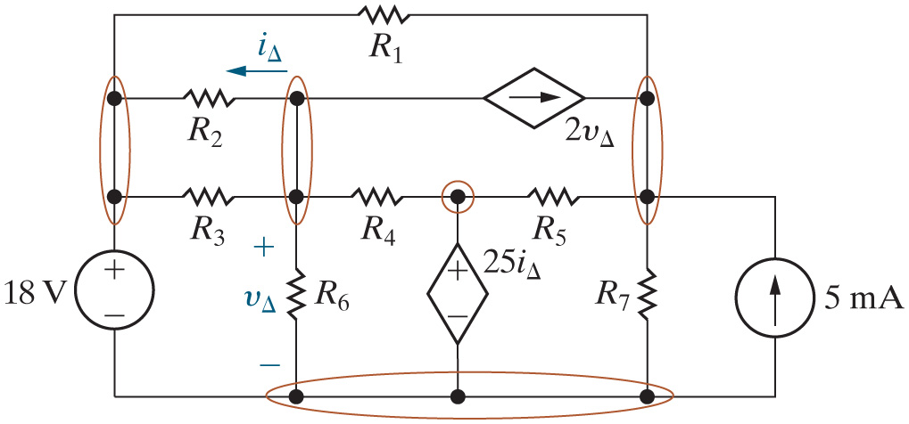
Chapter 4 – techniques of circuit analysis (3 of 26)
Identify all of the nodes in this circuit.

Slide 5
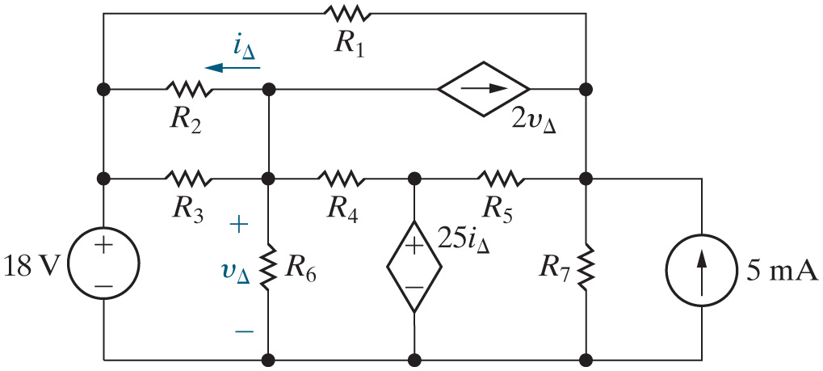


Chapter 4 – techniques of circuit analysis (4 of 26)
How many essential nodes does this circuit have?
A. 4
B. 5
C. 7
D. 10

Slide 6








Chapter 4 – techniques of circuit analysis (5 of 26)
Identify all of the loops in this circuit.
dep. source,
Dep. Source,
dep. source,
Etc

Slide 7
Chapter 4 – techniques of circuit analysis (6 of 26)
How many meshes does this circuit have?
A. 4
B. 5
C. 7
D. 10

Slide 8
Chapter 4 – techniques of circuit analysis (7 of 26)
Node voltage method:
  Based on writing K C L equations at essential nodes
  Solves for node voltages
  Analysis Method 4.1
    Identify each essential node.
    Pick and label a reference node; then label the node voltages at the remaining essential nodes.
    Write a K C L equation for every nonreference essential node.
    Solve the equations to find the node-voltage values.
    Solve the circuit using node voltages from Step 4 to find component currents, voltages, and power values.

Slide 9
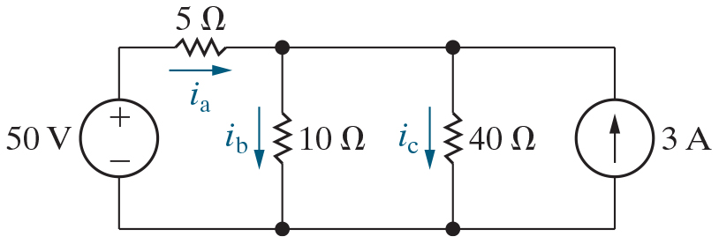
Chapter 4 – techniques of circuit analysis (8 of 26)
Use the node voltage method to find the currents shown in this circuit.

Slide 10
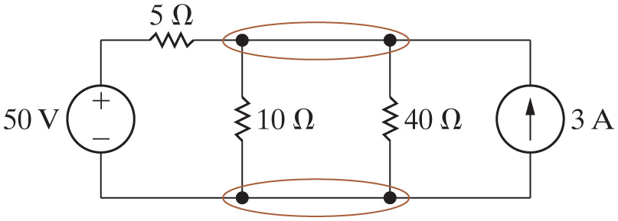
Chapter 4 – techniques of circuit analysis (9 of 26)
Node voltage method:
  Step 1 – Identify each essential node.

Slide 11
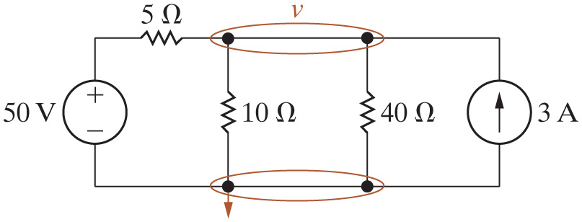
Chapter 4 – techniques of circuit analysis (10 of 26)
Node voltage method:
  Step 2 – Pick and label a reference node; then label the node voltages at the remaining essential nodes.

Slide 12
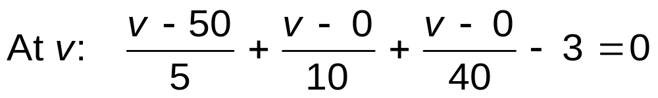
Chapter 4 – techniques of circuit analysis (11 of 26)
Node voltage method:
  Step 3 – Write a K C L equation for every nonreference essential node.

Slide 13
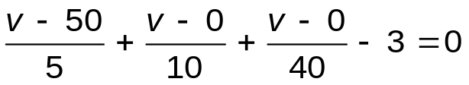
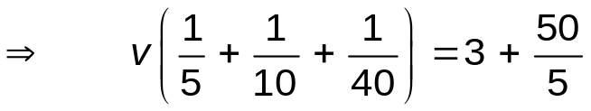
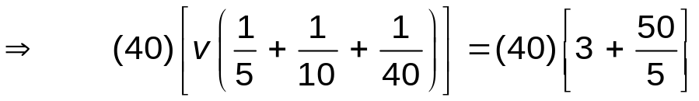

Chapter 4 – techniques of circuit analysis (12 of 26)
Node voltage method:
  Step 4 – Solve the equations to find the node-voltage values.
Notes:
Long Description:
Forward arrow, Open Parenthesis 40 Close Parenthesis Open Square Bracket v Open Parenthesis StartFraction 1 over 5 End Fraction plus StartFraction 1 over 10 End Fraction plus StartFraction 1 over 40 End Fraction Close Parenthesis Close Square Bracket equals Open Parenthesis 40 Close Parenthesis Open Square Bracket 3 plus StartFraction 50 over 5 End Fraction Close Square Bracket.

Slide 14
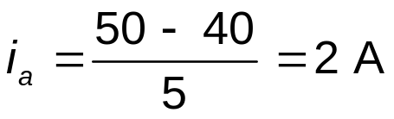
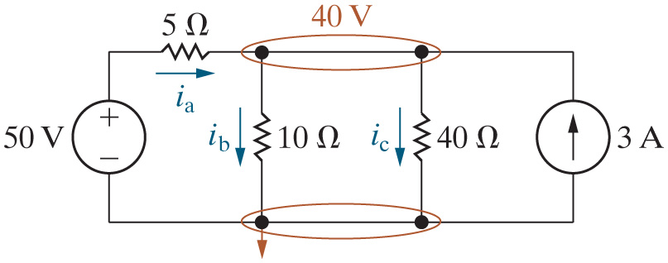
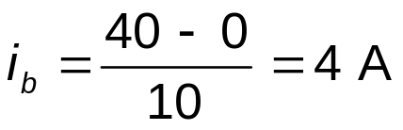
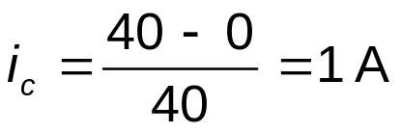
Chapter 4 – techniques of circuit analysis (13 of 26)
Node voltage method:
  Step 5 – Solve the circuit using node voltages from Step 4.

Slide 15
Chapter 4 – techniques of circuit analysis (14 of 26)
We just showed that the voltage drop between the top node and the reference node in this circuit is 40 V. Find the power for the current source.
A. 120 W
B. −100 W
C. −120 W
D. 40 W

Slide 16





Chapter 4 – techniques of circuit analysis (15 of 26)
Node voltage method:
Check that the power balances:

Slide 17
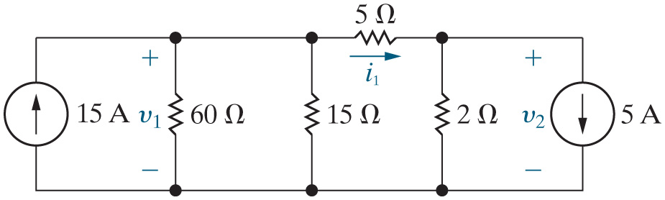
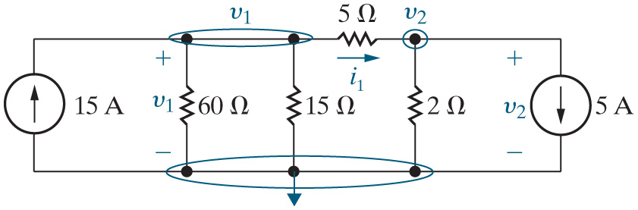
Chapter 4 – techniques of circuit analysis (16 of 26)
Node voltage method:
  Find the two voltages and the current indicated.
Step 1 – Identify each essential node.
Step 2 – Pick and label a reference node; then label the node voltages at the remaining essential nodes.

Slide 18

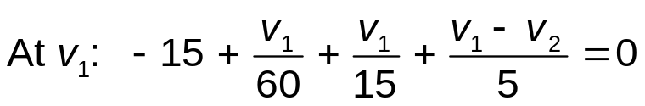
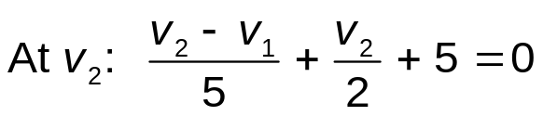
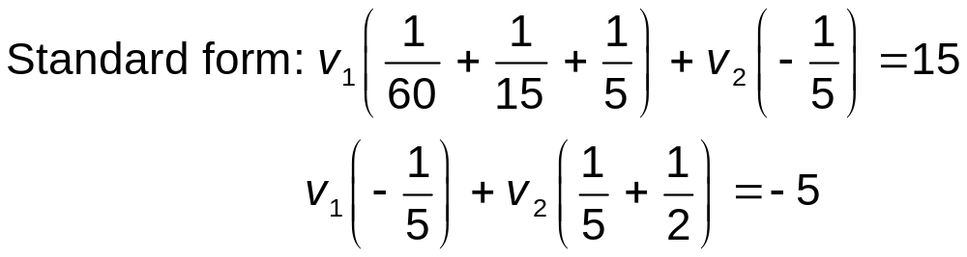
Chapter 4 – techniques of circuit analysis (17 of 26)
Node voltage method:
  Step 3 – Write a K C L equation for every nonreference essential node.
  Step 4 – Solve the equations to find the node-voltage values.
Notes:
Long Description 1:
At v subscript 1 BaseLine: negative 15 plus StartFraction v subscript 1 BaseLine over 60 End Fraction plus StartFraction v subscript 1 BaseLine over 15 End Fraction plus StartFraction v subscript 1 BaseLine minus v subscript 2 BaseLine over 5 End Fraction equals 0.
Long Description 2:
v subscript 1 BaseLine Open Parenthesis 1 divided by 60 plus 1 divided by 15 plus 1 divided by 5 Close Parenthesis plus v subscript 2 BaseLine Open Parenthesis negative 1 divided by 5 Close Parenthesis equals 15.
v subscript 1 BaseLine Open Parenthesis negative 1 divided by 5 Close Parenthesis plus v subscript 2 BaseLine Open Parenthesis 1 by 5 plus 1 by 2 Close Parenthesis equals negative 5.

Slide 19
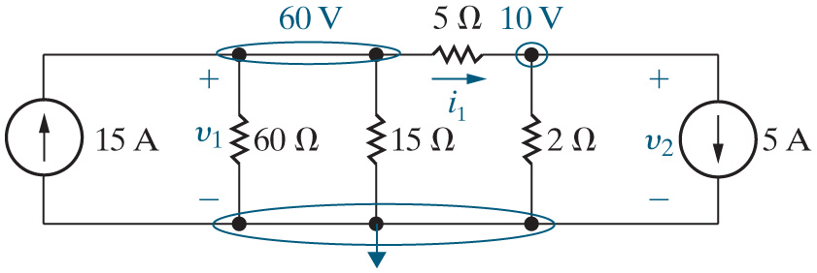

Chapter 4 – techniques of circuit analysis (18 of 26)
Node voltage method (continued):
  Step 5 – Solve the circuit using node voltages from Step 4.

Slide 20



Chapter 4 – techniques of circuit analysis (19 of 26)
If
is 60 V and
is 10 V, what is the power associated
with the
resistor?
A. 60 W
B. 240 W
C. 3600 W
D. None of the above

Slide 21
Chapter 4 – techniques of circuit analysis (20 of 26)
If
is 60 V and
is 10 V, what is the power associated
with the 5 A source?
A. 900 W
B. −900 W
C. −50 W
D. 50 W

Slide 22


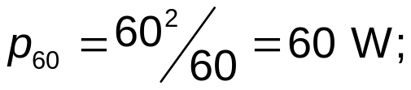
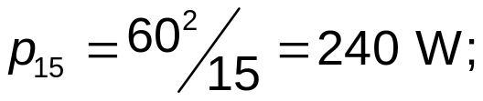
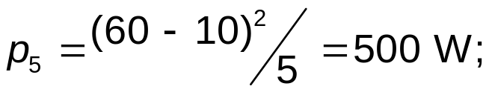
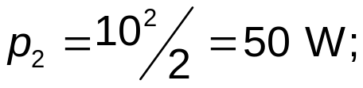

Chapter 4 – techniques of circuit analysis (21 of 26)
Node voltage method (continued):
  Check that the power balances

Slide 23
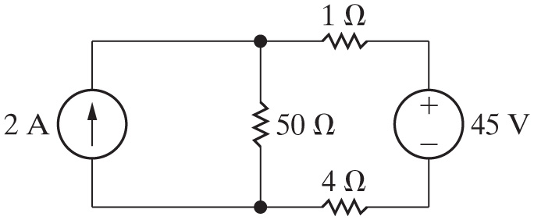
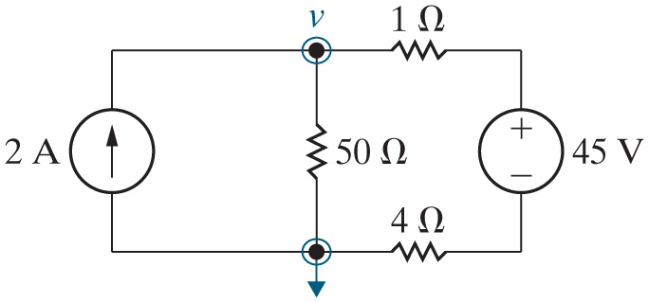
Chapter 4 – techniques of circuit analysis (22 of 26)
Node voltage method:
  Find the power associated with the current source.
Step 1 – Identify each essential node.
Step 2 – Pick and label a reference node; then label the node voltages at the remaining essential nodes.

Slide 24
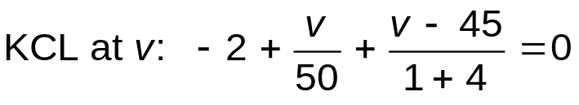


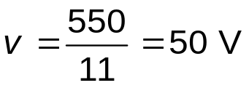
Chapter 4 – techniques of circuit analysis (23 of 26)
Node voltage method:
  Step 3 – Write a K C L equation for every nonreference essential node.
  Step 4 – Solve the equations to find the node-voltage values.
Notes:
Long Description:
Open Parenthesis 50 Close Parenthesis Open Square Bracket v Open Parenthesis StartFraction 1 over 50 End Fraction plus StartFraction 1 over 5 End Fraction Close Parenthesis equals 2 plus StartFraction 45 over 5 End Fraction Close Square Bracket, forward arrow, v Open Parenthesis 1 plus 10 Close Parenthesis equals 100 plus 450, therefore.

Slide 25
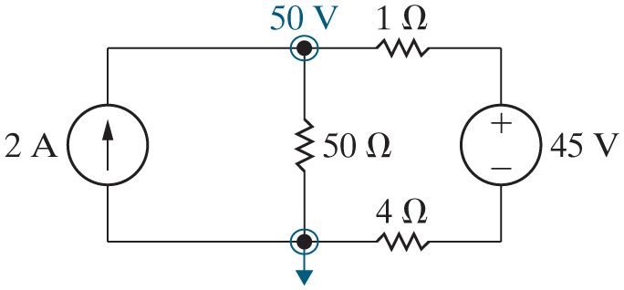

Chapter 4 – techniques of circuit analysis (24 of 26)
Node voltage method:
  Step 5 – Solve the circuit using node voltages from Step 4.
Power for the current source:

Slide 26
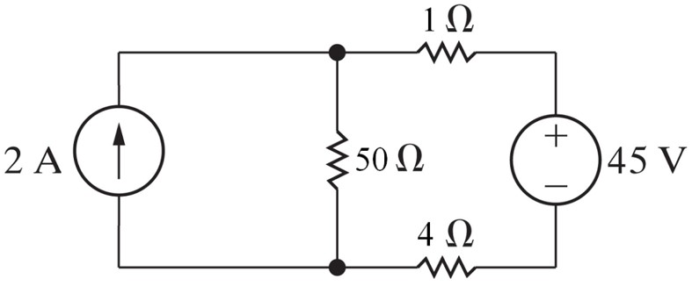
Chapter 4 – techniques of circuit analysis (25 of 26)
The current source is absorbing power.
A. True
B. False

Slide 27







Chapter 4 – techniques of circuit analysis (26 of 26)
Power balance:
Component | Equation | p [W]
2 A | −(2)(50) | −100
45 V | Open Parenthesis 45 Close Parenthesis Open Square Bracket Open Parenthesis 50 minus 45 Close Parenthesis divided by 5 Close Square Bracket. | 45
1 Ohm. | Open Parenthesis 1 Close Parenthesis squared multiplied by Open Parenthesis 1 Close Parenthesis. | 1
4 Ohms. | Open Parenthesis 1 Close Parenthesis squared multiplied by Open Parenthesis 4 Close Parenthesis. | 4
50 Ohms. | Open Parenthesis 50 Close Parenthesis squared divided by 50 | 50

Slide 28

Copyright
This work is protected by United Kingdom copyright laws and is provided solely for the use of instructors in teaching their courses and assessing student learning. Dissemination or sale of any part of this work (including on the World Wide Web) will destroy the integrity of the work and is not permitted. The work and materials from it should never be made available to students except by instructors using the accompanying text in their classes. All recipients of this work are expected to abide by these restrictions and to honor the intended pedagogical purposes and the needs of other instructors who rely on these materials.

